Slide 1

JK INSTITUTE OF ENGINEERING
Smart
QR Code
Generator

Slide 2
Smart QR Code Generator
JK INSTITUTE OF ENGINEERING BILASPUR
DEPARTMENT OF COMPUTER SCIENCE
SESSION 2022-2023
Software Engineering and Project Management
Project On
Name :- Aman Sahu, Khemraj Dewangan
Branch:- CSE
Semester:- 6th
Guided by:- Vikas Dubey
(Assistant Professor)
Department Of Computer Science

Slide 3
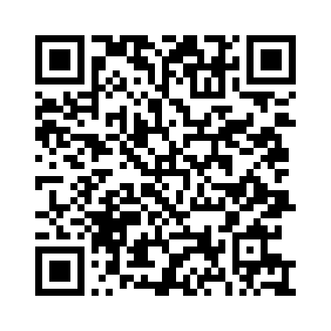
About Smart QR Code Generator Project
The Full form of QR is Quick response it means reply quickly QR code is a trademark of a type of matrix bar-codes.
Which was created in Japan to recognize the automotive industry there it is a square 2-D box.
In which pictures are made on a with background

Slide 4
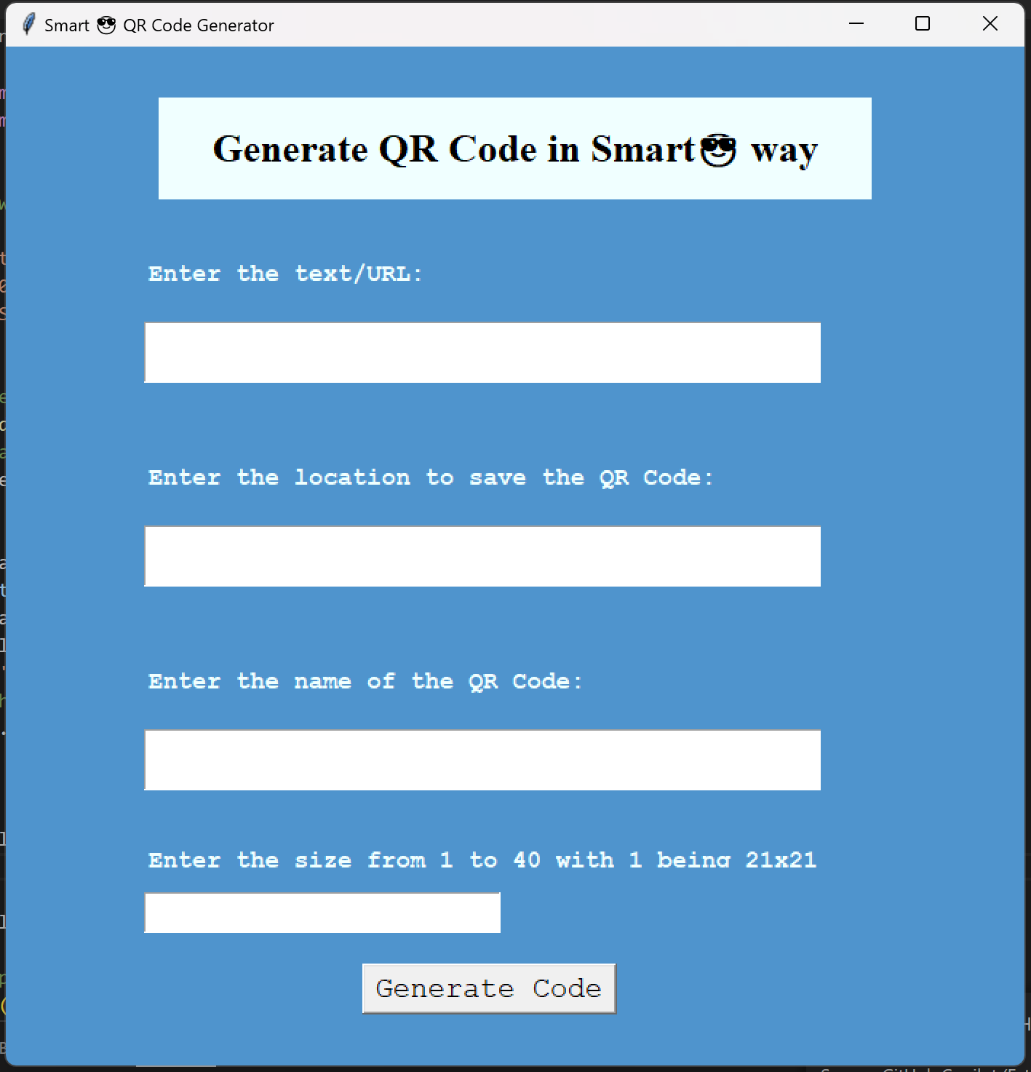
Final Output ->

Slide 5

CSE Department-

Slide 6
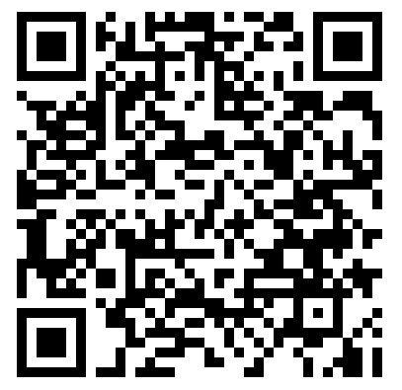
What is the advantage of a QR code over a text URL?
Ans.- Quick and error-free But typing a URL is time-consuming and inconvenient on a mobile screen. Consumers are also likely to make errors while typing. Compared to this, scanning a QR Code is a much faster and error-free process.
https://scanova.io/blog/advantages-of-qr-code/

Slide 7
😎😊😁😉🤞😜😀😆🙂😍🫡😛😌😝
THANK YOU
😎😊😁😉🤞😜😀😆🙂😍🫡😛😌😝

